Slide 1
Operating Systems
SENS-3513
Week: 11
Process Synchronization -1
Operating System Concepts
9th edition
Silberschatz, Galvin & Gagne
John Wiley & Sons
2013
Dr Nauman Mazhar
Faculty of Information Technology (FIT)
University of Central Punjab (UCP)

Slide 2
Objectives
Cooperating processes
Process synchronization
Critical Section problem
  Solution to Critical Section problem
Software based solutions
  For 2 processes:
    Strict alternation & Flags algorithms
    Peterson’s solution
Threads synchronization using Mutex
2

Slide 3
Cooperating Processes
Cooperating processes are processes that can affect or be affected by other processes
  share data & resources, and execution can be dependent on
  each other
  cooperation can occur thru IPC techniques – shared memory, message passing
When cooperating processes execute using shared memory, and scheduler switches rapidly between them
  a process might have executed partially, & other gets scheduled
  may lead to issues involving integrity of data, when processes access & update shared data
3
Notes:
Thread A: print “yes”
Thread B: print “no”
Discuss example of having lunch before saleem.
YOU: a1:eat breakfast, a2:work, a3:eat lunch, a4:call saleem.
SALEEM: b1:eat breakfast, b2:work, b3:wait for call, b4:eat lunch

Slide 4
Process Synchronization
  “Process synchronization involves mechanisms and approaches
  that ensure orderly execution of cooperating processes
  that share data & resources,
  in order to maintain data consistency”
Synchronization is also needed for threads…
  share address space
  can communicate directly through shared variables
Let’s see why cooperating processes (or threads) may need synchronization…
4
Notes:
Thread A: print “yes”
Thread B: print “no”
Discuss example of having lunch before saleem.
YOU: a1:eat breakfast, a2:work, a3:eat lunch, a4:call saleem.
SALEEM: b1:eat breakfast, b2:work, b3:wait for call, b4:eat lunch

Slide 5
Example 1 - Producer Consumer
#define BUFF_SIZE 5
typedef struct{ ---- } item;
item buff[BUFF_SIZE];
int in = 0; //points to first empty location in buffer
where next item will be placed by producer
int out = 0; //points to first filled location in buffer
from where next item is to be consumed
int ctr = 0; //number of items in buffer
Producer Process
item nextProduced;
while(1)
{
nextProduced = getItem();
while(ctr == BUFF_SIZE)
; //do nothing
buff[in] = nextProduced;
in = (in + 1) % BUFF_SIZE;
ctr++; }
Consumer Process
item nextConsumed;
while(1)
{
while(ctr == 0)
; //do nothing
nextConsumed = buff[out];
out = (out + 1) % BUFF_SIZE;
ctr--;
}
5

Slide 6
Example 1 - Producer Consumer
Producer and Consumer processes need to access shared data,
ctr & buffer
  ctr is shared variable, checks whether buffer is empty/full
  ctr is updated by both producer & consumer
How can access to shared data result in data inconsistency…
  the instructions ctr++ & ctr-- can be written in assembly language as:
ctr++;
P₁: MOV R1, ctr
P₂: INC R1
P₃: MOV ctr, R1
ctr--;
C₁: MOV R2, ctr
C₂: DEC R2
C₃: MOV ctr, R2
6

Slide 7
Example 1 - Producer Consumer
ctr++;
P₁: MOV R1, ctr
P₂: INC R1
P₃: MOV ctr, R1
ctr--;
C₁: MOV R2, ctr
C₂: DEC R2
C₃: MOV ctr, R2
Assume value of ctr is initially 4
If instructions execute concurrently, they may interleave
Final value of ctr for various interleave sequences would be…
  1st possible sequence: P₁, P₂ , C₁, C₂, P₃ , C₃
  final value of ctr is 3, whereas actual result should be 4
  2nd interleave sequence: P₁, P₂ , C₁, C₂, C₃ , P₃
  what is final result?
if Consumer runs last -> ctr = 3
if Producer runs last -> ctr = 5
7

Slide 8
Example 2 - Deposit & Withdrawal
Consider a Bank Transaction…
  deposit process deposits an amount in bank, via cheque
  withdrawl process withdraws an amount, via ATM
In these processes, instructions to update “balance” variable can be written in assembly as…
Deposit
D₁: MOV R1, balance
D₂: ADD R1, depositAmount
D₃: MOV balance, R1
Withdrawal
W₁: MOV R2, balance
W₂: SUB R2, wdrAmount
W₃: MOV balance, R2
Sample Transaction
Current Balance: 100/-
Cheque deposited: 25/-
ATM withdrawl: 10/-
8
Notes:
First result is 90/- instead of 115/-
Second result is 125/- instead of 115/-

Slide 9
Example 2 - Deposit & Withdrawal
Deposit
D₁: MOV R1, balance
D₂: ADD R1, depositAmount
D₃: MOV balance, R1
Withdrawal
W₁: MOV R2, balance
W₂: SUB R2, wdrAmount
W₃: MOV balance, R2
Sample Transaction
Current Balance: 100/-
Cheque deposited: 25/-
ATM with drawl: 10/-
Interleaving: One possible interleaving of above statements:
  D₁, D₂ , W₁, W₂, D₃ , W₃.
  (with this sequence, final value of balance will be 90/-)
  What is final result if interleaving is: D₁, D₂ , W₁, W₂, W₃ , D₃
9
Notes:
First result is 90/- instead of 115/-
Second result is 125/- instead of 115/-

Slide 10
Example - Race Condition
long balance = 0;
void * inc(void * arg);
void * dec(void * arg);
int main(){
pthread_t t1, t2;
pthread_create(&t1, NULL, inc, NULL);
pthread_create(&t2, NULL, dec, NULL);
pthread_join(t1,NULL); pthread_join(t2,NULL);
printf("Value of balance is :%ld\n", balance);
return 0;
}
void * inc(void * arg){
for(long i=0;
i<100000000; i++)
balance++;
pthread_exit(NULL);
}
void * dec(void * arg){
for(long i=0;
i<100000000; i++)
balance--;
pthread_exit(NULL);
}
10

Slide 11
Important Concepts
Race Condition
  situation where several cooperating processes/threads try to update the same shared data concurrently
  final value of data depends on which thread finishes last
Critical Section
  piece of code in cooperating processes/threads in which they
  may access & update some shared data – variable, file, DB
Critical Section Problem
  multiple cooperating processes/threads may try to execute their CS simultaneously
  need a mechanism to allow them to execute their CS,
  one by one, completely, without interruption
11

Slide 12
Important Concepts
For CS to run un-interrupted, we need atomic operations:
Atomic Operation
  “operation that always runs to completion, or not at all”
  Indivisible – cannot be interrupted
  state not modified by other processes, during the operation
  fundamental building block for synchronization
On most machines…
  memory references & assignment of words are atomic
  (e.g, loads & stores)
  in other cases, specific mechanisms or locks are used to ensure atomicity of critical sections
12
Notes:
Most of the time, threads are working on separate data, so scheduling doesn’t matter:
Thread A Thread B
x = 1; y = 2;
However, What about (Initially, y = 12):
Thread A Thread B
x = 1; y = 2;
x = y+1; y = y*2;
What are the possible values of x?
Or, what are the possible values of x below?
Thread A Thread B
x = 1; x = 2;
X could be 1 or 2 (non-deterministic!)
Could even be 3 for serial processors:
Thread A writes 0001, B writes 0010.
Scheduling order ABABABBA yields 3!
Process 1 Process 2 Memory Value
Read value 0
Read value 0
Flip value 1
Flip value 1

Slide 13
Critical Section Problem
Consider a system consisting of n processes P₀, P₁, ..., P_{n-1}
  each process may have a Critical Section
  to avoid data inconsistency…
  “No two processes should execute their CS at the same time”
Need a protocol – process must Request Permission to enter CS
  Entry section – code where process requests permission
  uses synchronization primitive to manage access
  Exit section – code where process releases control of CS
  resets the primitive to allow others to proceed
  Remainder section (RS) – remaining code, that does not involve
  shared resources
13

Slide 14
Structure of CS Solution
do {
ENTRY SECTION
<CS> // access shared variables
EXIT SECTION
<RS> // do other work
} while (1);
14

Slide 15
Structure of CS Solution
void process() {
// Entry Section – Acquire the lock
while (lock) {
// Busy-wait, or yield the CPU
}
lock = true;
// Critical Section; code that accesses shared resources
access_shared_resource();
// Exit Section – Release the lock
lock = false;
// Remainder Section; no interaction with shared resources
do_other_stuff();
}
15

Slide 16
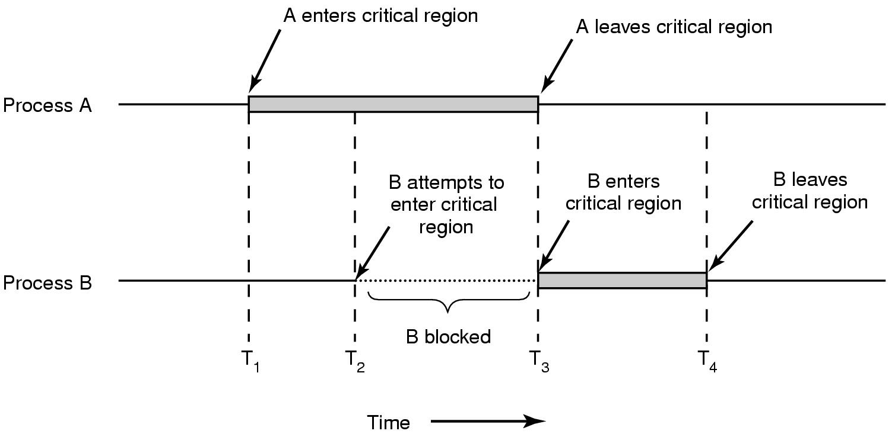
Critical Section Timeline - Example
16

Slide 17
Solution of CS Problem - Properties
In the context of solving CS problem, there are three key requirements:
  Mutual exclusion
  Progress
  Bounded waiting
Mutual Exclusion
  If process P_{i} is executing in its CS, no other cooperating process
  can be executing in its CS
    crucial to prevent race conditions
    ensures shared resources are accessed safely
17

Slide 18
Solution of CS Problem - Properties
Progress
  If no process is executing in its CS, and some processes wish to enter their CS, two things need to happen:
    only those processes not executing in their <RS> can take part
    in deciding which process will enter its CS next
    selection cannot be postponed indefinitely
  Progress ensures that…
    decision of which process enters the CS, should depend only on processes currently trying to enter their CS
    processes do not get stuck forever in entry section
    some process will make progress towards entering the CS
    No Deadlock…!!!
18

Slide 19
Solution of CS Problem - Properties
Bounded Wait
  If a process has requested to enter its CS, a bound must exist on the number of times other processes are allowed to enter their CS, before the request is granted
  This property ensures that…
    no process is blocked indefinitely from entering its CS
    No Starvation…!!!
Example:
Consider three processes P1, P2, P3; and let the bound be set to 1
  P2 makes a request to enter its CS
  then P1 & P3 also request to enter their CS
  for bounded wait of 1, P1 & P3 may enter their CS only once
  after that, P2 must be allowed to enter its CS
19

Slide 20
  Software Based Solutions
20

Slide 21
Algorithm with Strict Alternation
Synchronization for two processes P₀ & P₁
turn → global/shared variable → initially, turn = 0
when turn = i → P_{i} can enter its CS, otherwise waits in loop
Process P₀
do {
//Entry section
while (turn!=0);
<CS>
//Exit section
turn = 1;
<RS>
} while (1);
Process P₁
do {
//Entry section
while (turn!=1);
<CS>
//Exit section
turn = 0;
<RS>
} while (1);
21
Notes:
Test for Characteristics of Good Solution
Mutual Exclusion: Holds, because if P0 is in its CS then P1 cannot enter its CS. Assumption is that turn is accessed mutually exclusively.
Progress: Does not hold because of strict alternation, eg. Two brothers playing video game.
Bounded Wait:

Slide 22
Algorithm Using Flags
Solves limitation of strict alternation
Uses Boolean variables → boolean flag [2] flag [0] = flag [1] = false
Process sets its flag True → intent to enter CS
Checks other process flag → if True, keep spinning in loop
Process P₀
do {
//Entry section
flag[0] = true;
while (flag[1]==true);
<CS>
//Exit section
flag [0] = false;
<RS>
} while (1);
Process P₁
do {
//Entry section
flag[1] = true;
while (flag[0]==true);
<CS>
//Exit section
flag [1] = false;
<RS>
} while (1);
22
Notes:
Test for Characteristics of Good Solution
Mutual Exclusion: holds
Progress: does not hold
Bounded Wait: does not hold

Slide 23
Peterson’s Algorithm
Combines shared variables of previous two algorithms
  keeps two Boolean flags, one for each process
  has a shared integer variable turn
Boolean flag [2]; // initialized to False
int turn = 0;
Before entering CS, each process…
  sets its own flag TRUE
  makes turn equal to other’s process ID
(I’m interested to enter my CS, but if you want, go first)
Process then enters its while() loop, & checks…
  does other process want to enter its CS, & is it their turn
  if yes, spin
23
Notes:
I want to go but you go first

Slide 24
Peterson’s Algorithm
Process P₀
do {
flag[0] = true;
turn = 1;
while (flag[1] &&
turn == 1); //spin
<CS>
flag [0] = false;
<RS>
} while (1);
Process P₁
do {
flag[1] = true;
turn = 0;
while (flag[0] &&
turn == 0); //spin
<CS>
flag [1] = false;
<RS>
} while (1);
24
Notes:
Test for Characteristics of Good Solution
Mutual Exclusion: Holds
Progress: Holds
Bounded Wait: Suppose P0 show its willingness to enter its CS by setting its flag to true. Now P1 executes and enters its CS. Once P1 exits the CS it set its flag to false. Now even if P1 again tries to enter its CS again, it can’t because flag[0] is true and turn is also set to zero by P1 before entering the while loop. So P1 will spin and P0 enters its CS. So the bound is set to ONE.

Slide 25
Peterson’s Algorithm
Mutual Exclusion
  if one process is in CS, and the other wishes to access, it is denied
  ensured by check on flags and turn variable in while() loop
Progress
  if no process is in CS, and both processes wish to execute their CS, one of the processes will be allowed access
  ensured by turn variable
Bounded Waiting
  when a process indicates its desire to enter CS, turn variable will allow access after the other process has executed its CS once
But algo is primarily theoretical, due to busy-wait inefficiency.
May not work on modern architectures, due to how
they handle load/store
25
Notes:
I want to go but you go first

Slide 26
  Hybrid Solutions
  Mutex
26

Slide 27
Solution to CS Problem
Need to protect the CS
  problem due to interleaving of machine instructions
Hardware based solution
  many modern systems provide special H/W instructions…
  allow to perform some operations atomically;
  test/set contents of a word, or compare & swap two words
  but H/W based solutions need careful consideration for use
    generally not available to application developers
    availability also depends on processor & architecture
Hybrid solutions
  synchronization primitives provided by OS (mutex, semaphore)
  implemented in S/W
  rely on atomic operations provided by underlying H/W
27

Slide 28
Mutex: Thread Synchronization
Mutex
  S/W tool provided by OS – protect CS & prevent race conditions
  process needs to acquire the lock, and then it can enter CS
  if lock not available, process waits in entry section
do {
ENTRY SECTION // acquire() mutex lock
<CS> // access shared variables
EXIT SECTION // release() mutex lock
<RS> // do other work
} while (1);
28

Slide 29
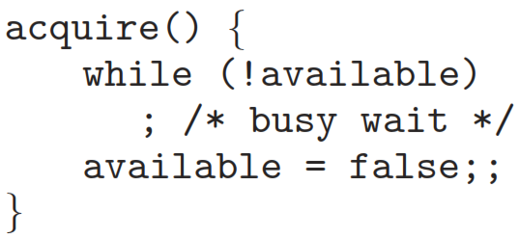
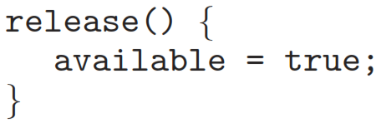
Mutex: Thread Synchronization
Mutex implementation
  two functions – acquire() and release()
    lock mechanism uses a Boolean variable “available”
    value of variable indicates if lock is available or not
  if lock available : call to acquire() succeeds
    (lock then considered un-available for others)
  initial value of available = True;
29

Slide 30
Mutex: Thread Synchronization
Calls to acquire() & release() must be performed atomically
  ensured by hardware mechanisms provided by system
  Linux OS guarantees that race condition does not occur among threads attempting to lock a mutex
Mutex can be locked by only one thread at a time…
  if one thread locks a mutex
  and then a second thread also tries to lock same mutex
  second thread enters busy wait
  when first thread unlocks the mutex
  second thread allowed access to CS
30

Slide 31
Use of Mutex
Create & initialize a mutex variable
Several threads may attempt to lock the mutex
  only one thread succeeds – this thread owns the mutex
  owner thread executes its CS – my update shared data
  owner thread unlocks the mutex
Now, another thread may acquire the mutex
Finally, mutex is destroyed
  any thread can destroy a mutex
  safe destruction requires…
    no thread owns the mutex – mutex is unlocked
    no threads blocked on mutex – waiting to lock it
31

Slide 32
Use of Mutex - pthreads
Mutex declaration and initialization
static pthread_mutex_t mut = PTHREAD_MUTEX_INITIALIZER;
Request to lock mutex object referenced by mptr
int pthread_mutex_lock( pthread_mutex_t * mptr);
  used when thread wants to enter CS
  if mutex already locked, calling thread enters busy wait, until
  mutex becomes available
Releasing mutex object referenced by mptr
int pthread_mutex_unlock( pthread_mutex_t * mptr);
  used when thread comes out of CS
  call should be made only by owner thread
32

Slide 33
Example (Race Condition)
long balance = 0;
void * inc(void * arg);
void * dec(void * arg);
int main(){
pthread_t t1, t2;
pthread_create(&t1, NULL, inc, NULL);
pthread_create(&t2, NULL, dec, NULL);
pthread_join(t1,NULL); pthread_join(t2,NULL);
printf("Value of balance is :%ld\n", balance);
return 0;
}
void * inc(void * arg){
for(long i=0;
i<1000000; i++)
balance++;
pthread_exit(NULL);
}
void * dec(void * arg){
for(long i=0;
i<1000000; i++)
balance--;
pthread_exit(NULL);
}
33

Slide 34
Example (Sol: Race Condition)
long balance = 0;
pthread_mutex_t mut;
int main(){
pthread_t t1, t2;
pthread_mutex_init(&mut, NULL);
pthread_create(&t1, NULL, inc, NULL);
pthread_create(&t2, NULL, dec, NULL);
pthread_join(t1,NULL); pthread_join(t2,NULL);
pthread_mutex_destroy(&mut);
printf("Value of balance is :%ld\n", balance);
return 0;
}
void * dec(void * arg){
for(long i=0;i<1000000;i++){
pthread_mutex_lock(&mut);
balance--;
pthread_mutex_unlock(&mut);
}
pthread_exit(NULL);
}
void * inc(void * arg){
for(long i=0;i<1000000;i++){
pthread_mutex_lock(&mut);
balance++;
pthread_mutex_unlock(&mut);
}
pthread_exit(NULL);
}
34

Slide 35
Mutex: Pros & Cons
Disadvantage: Mutex requires busy-waiting
  if one process is in CS, and another tries to enter its CS, the second
  process loops continuously in call to acquire()
    process “spins” waiting for lock to be available – spinlock
  busy waiting is an issue in multiprogramming
    single CPU is shared among many processes
    looping wastes CPU cycles that others may use
Advantage: no context switching, when process waits on lock
  context switch takes time
  when lock expected for short times, spinlock is useful
  often employed on multiprocessor systems
    one thread spins on one processor
    another executes in CS on another processor
35

Slide 36
Mutex Mistakes
Do not lock a mutex that is already locked
Do not unlock a mutex that is already unlocked
Only the owner of mutex, should unlock the mutex
Do not destroy a locked mutex
36

